Slide 1

CSCI 466: Networks
Network Security
Reese Pearsall Fall 2022
https://www.cs.montana.edu/pearsall/classes/fall2022/466/main.html
*All images are stolen from the internet
1

Slide 2
Announcements
PA3 Due TONIGHT
Office hours on Wednesday are moved to 9-10 AM
Wireshark Lab 2
Rest of Semester

Slide 3
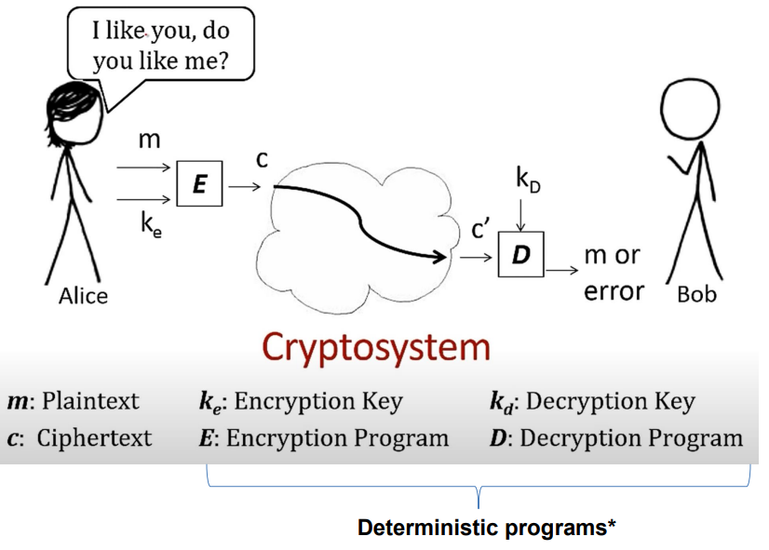
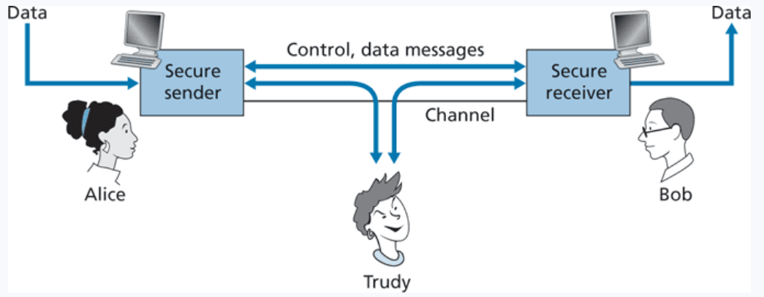
Principles of Cryptography
Presentation Layer
Goal: Only the sender and intended receiver should be able to understand the contents of a transmitted message (confidentiality), so sender must find a way to encrypt his message
Session Layer

Slide 4
Principles of Cryptography
Presentation Layer
Goal: Only the sender and intended receiver should be able to understand the contents of a transmitted message (confidentiality), so sender must find a way to encrypt his message
Session Layer
*We also need to make sure that the message is not tampered with before arrival (message integrity) and that both parties can identify each other (authentication)

Slide 5
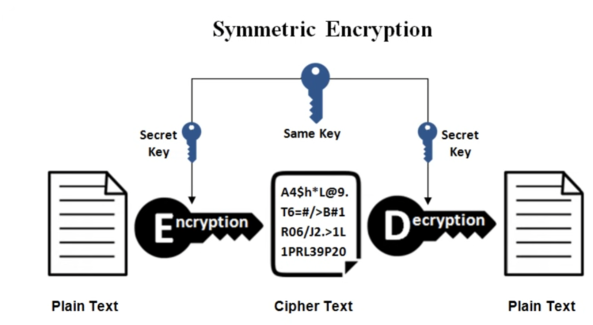
Symmetric Key Cryptography
Symmetric Key Cryptography is a type of encryption where only one key (a secret key) is used to both encrypt and decrypt electronic information

Slide 6
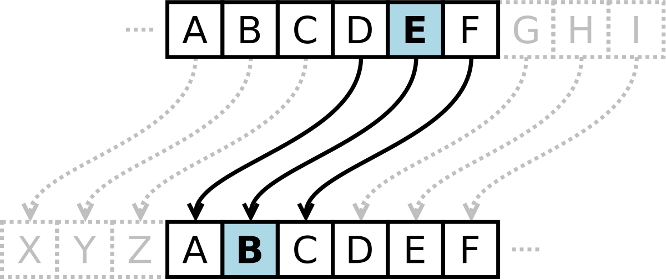
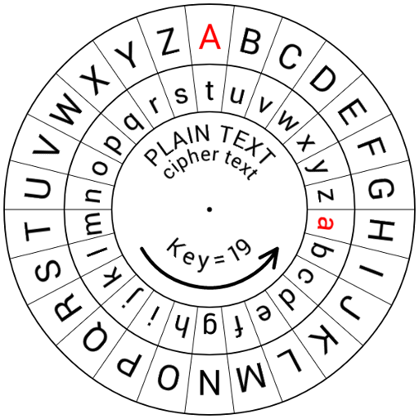
Early Symmetric Key Cryptography
Caesar Cipher- Each letter in plaintext is replaced by a letter some fixed number of positions down the alphabet
Shift of 3
Brown Lazy Fox → Eurzq Odcb Ira
If you did not know the key, how difficult would it be to crack a Caesar cipher?

Slide 7
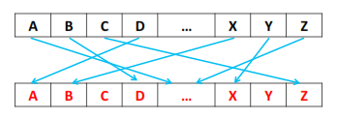
Early Symmetric Key Cryptography
What does a key look like?
Monolithic Substitution Cipher- each letter of the plain text is replaced with another letter of the alphabet (no fixed length position)
26-Characters
“EABZTIVGSKXFJPYCDWONMHQLRU”
If we don’t know the key, how difficult would it be to brute force this?

Slide 8
Early Symmetric Key Cryptography
What does a key look like?
Monolithic Substitution Cipher- each letter of the plain text is replaced with another letter of the alphabet (no fixed length position)
26-Characters
“EABZTIVGSKXFJPYCDWONMHQLRU”
If we don’t know the key, how difficult would it be to brute force this?
26! Possible permutations
However, we can leverage the fact that certain characters appear more commonly in the English language (a, e, i, t, r) to make guessing much easier
(frequency analysis)

Slide 9
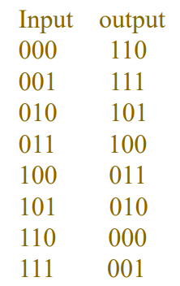
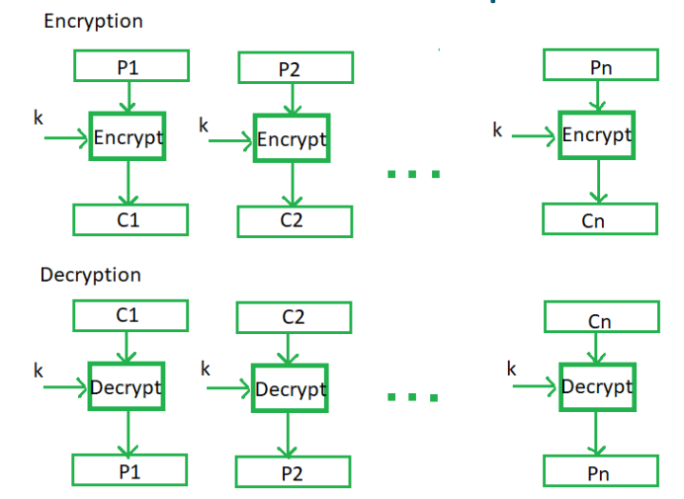
Block Cipher
Plaintext is divided into n-sized blocks and each block is encrypted independently
3-bit Block Cipher Table
Key!
010000111→

Slide 10
Block Cipher
Plaintext is divided into n-sized blocks and each block is encrypted independently
3-bit Block Cipher Table
Key!
010000111→101110001

Slide 11
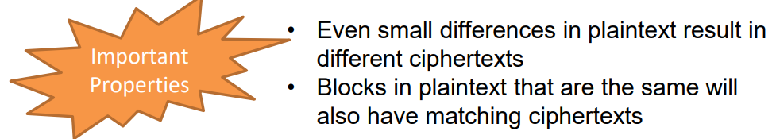
Block Cipher
Plaintext is divided into n-sized blocks and each block is encrypted independently
010000111→101110001
Typically, the block sizes are going to be 64 bits or even larger
# of mappings general formula: 2^{k}!

Slide 12

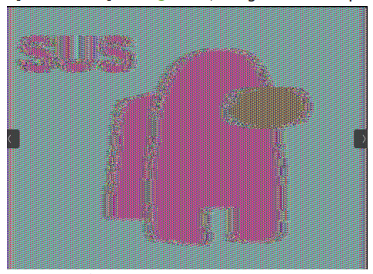
Block Cipher
If identical keys are used:
Think about storing table information for 64 block size ☹

Slide 13
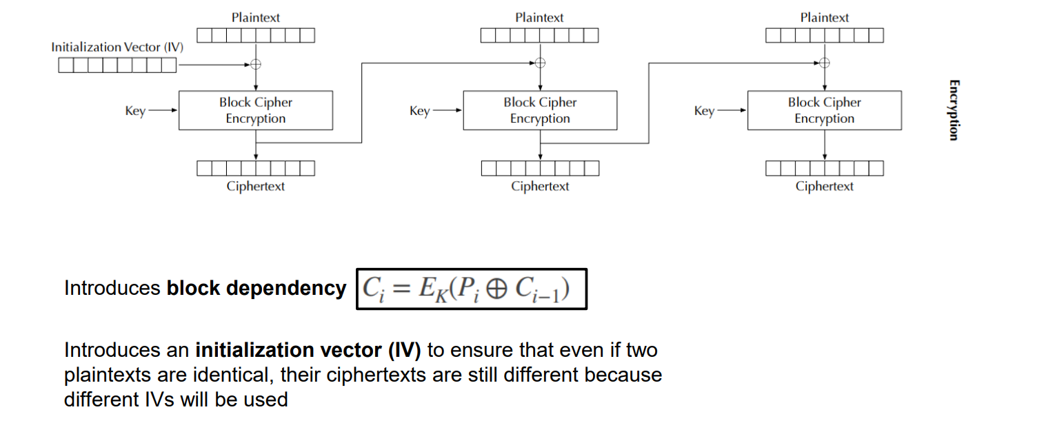
Block Cipher
Cipher Block Chaining (CBC) Mode
Rather than using predetermined tables, block ciphers usually use some type of function that simulate randomly permutated tables

Slide 14
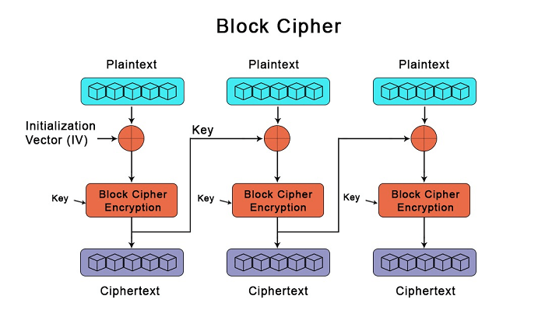
Symmetric key encryption uses the same, shared, key for encrypting and decrypting
What is the one major hurdle we have not discussed yet?
How do the keys get sent without being intercepted? Do the keys get encrypted?

Slide 15
Asymmetric Cryptography
AKA Public key Cryptography
The keys used for encrypting and decrypting data are different
Additionally, each user now gets two-keys. A public key, and a private key
This involves some complicated math, and I won’t go super deep into it. YouTube videos can explain it much better than I can
RSA (Rivest–Shamir–Adleman) is the most popular public key cryptosystem. We rely on it whenever we do communicate securely on the internet

Slide 16


Asymmetric Cryptography (RSA)
Alice
Bob
Plaintext
Alice has a plaintext that she wants to send to bob

Slide 17


Asymmetric Cryptography (RSA)
Alice
Bob
Public Key
Encrypt!
Plaintext
Ciphertext
She uses Bob’s public key to encrypt her message

Slide 18

Asymmetric Cryptography (RSA)
Alice
Bob
Public Key
Plaintext
Ciphertext
Ciphertext is sent over some medium
Eve can intercept this message,
But can’t decrypt it (public key is not used for decrypting!)

Slide 19
Asymmetric Cryptography (RSA)
Alice
Bob
Public Key
Private Key
Plaintext
Plaintext
Bob uses his private key to decrypt the message. Nobody else knows Bob’s private key
Decrypt
Ciphertext
Ciphertext
Ciphertext is sent over some medium
Eve can intercept this message,
But can’t decrypt it (public key is not used for decrypting!)

Slide 20
Asymmetric Cryptography (RSA)
If you multiply two prime numbers (p and q) together, the product can only be divisible by those two number
5183
??? * ??? = 5183
This is very difficult to figure out for the people that don’t know p or q
In fact, there is not an efficient program that can calculate the factors of integers
Remember what these are called?

Slide 21
Asymmetric Cryptography (RSA)
If you multiply two prime numbers (p and q) together, the product can only be divisible by those two number
5183
??? * ??? = 5183
This is very difficult to figure out for the people that don’t know p or q
In fact, there is not an efficient program that can calculate the factors of integers
This problem is in NP

Slide 22
Asymmetric Cryptography (RSA)
If you multiply two prime numbers (p and q) together, the product can only be divisible by those two number
RSA is based on large numbers that are difficult to factorize
The public and private keys are derived from these prime numbers
How long should RSA keys be? 1024 or 2048 bits long!
The longer the key = the more difficult to crack (exponentially)

Slide 23
Asymmetric Cryptography (RSA)
Eve’s stolen goods
Alice
Bob
p = 53
q = 59
Step 1: Choose two large primer numbers, p and q

Slide 24
Asymmetric Cryptography (RSA)
Eve’s stolen goods
Alice
Bob
p = 53
q = 59
n = 3127
Step 1: Choose two large primer numbers, p and q
Step 2: Calculate the product n

Slide 25
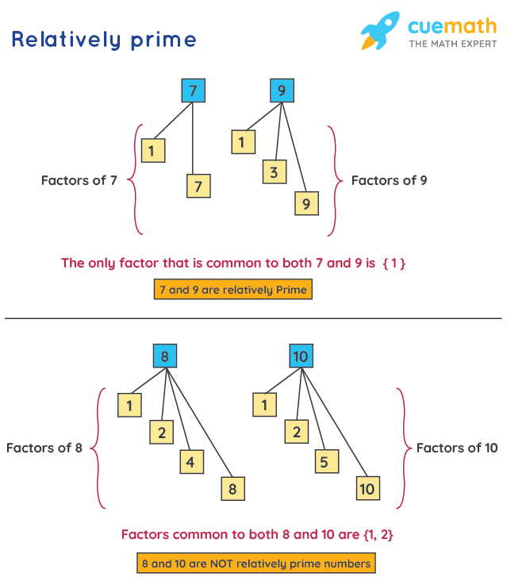
Asymmetric Cryptography (RSA)
Eve’s stolen goods
Alice
Bob
p = 53
q = 59
n = 3127
Φ(n) = number of values less than n which are relatively prime to n
1
2
3
…
3125
3126
How many of these numbers are relatively prime w/ 3127?
Step 1: Choose two large primer numbers, p and q
Step 2: Calculate the product n
Step 3: Calculate Φ(n)

Slide 26
Asymmetric Cryptography (RSA)
Eve’s stolen goods
Alice
Bob
p = 53
q = 59
n = 3127
Φ(n) = number of values less than n which are relatively prime to n
1
2
3
…
3125
3126
How many of these numbers are relatively prime w/ 3127?
Step 1: Choose two large primer numbers, p and q
Step 2: Calculate the product n
Step 3: Calculate Φ(n)
Difficult.. But very easy for the product of two prime #s!

Slide 27
Asymmetric Cryptography (RSA)
Eve’s stolen goods
Alice
Bob
p = 53
q = 59
n = 3127
Φ(n) = number of values less than n which are relatively prime to n
The Φ(n) of a product of two prime numbers will always be (p-1)(q-1)
Step 1: Choose two large primer numbers, p and q
Step 2: Calculate the product n
Step 3: Calculate Φ(n)

Slide 28
Asymmetric Cryptography (RSA)
Eve’s stolen goods
Alice
Bob
p = 53
q = 59
n = 3127
Φ(n) = 52*28 = 3016
Φ(n) = number of values less than n which are relatively prime to n
The Φ(n) of a product of two prime numbers will always be (p-1)(q-1)
Step 1: Choose two large primer numbers, p and q
Step 2: Calculate the product n
Step 3: Calculate Φ(n)

Slide 29
Asymmetric Cryptography (RSA)
Φ(n) = number of values less than n which are relatively prime to n
Eve’s stolen goods
Alice
Bob
p = 53
q = 59
n = 3127
Φ(n) = 3016
e = 1 < e < Φ(n)
Not be a factor of n, but an integer
Step 1: Choose two large primer numbers, p and q
Step 2: Calculate the product n
Step 3: Calculate Φ(n)
Step 4: Choose public exponent e

Slide 30
Asymmetric Cryptography (RSA)
Φ(n) = number of values less than n which are relatively prime to n
Eve’s stolen goods
Alice
Bob
p = 53
q = 59
n = 3127
Φ(n) = 3016
e = 3
e = 1 < e < Φ(n)
Not be a factor of n, but an integer
Step 1: Choose two large primer numbers, p and q
Step 2: Calculate the product n
Step 3: Calculate Φ(n)
Step 4: Choose public exponent e

Slide 31





Asymmetric Cryptography (RSA)
Φ(n) = number of values less than n which are relatively prime to n
Eve’s stolen goods
Alice
Bob
p = 53
q = 59
n = 3127
Φ(n) = 3016
e = 3
Step 1: Choose two large primer numbers, p and q
Step 2: Calculate the product n
Step 3: Calculate Φ(n)
Step 4: Choose public exponent e
Step 5: Select private exponent d
K = some integer that will make the quotient an integer

Slide 32





Asymmetric Cryptography (RSA)
Φ(n) = number of values less than n which are relatively prime to n
Eve’s stolen goods
Alice
Bob
p = 53
q = 59
n = 3127
Φ(n) = 3016
e = 3
Step 1: Choose two large primer numbers, p and q
Step 2: Calculate the product n
Step 3: Calculate Φ(n)
Step 4: Choose public exponent e
Step 5: Select private exponent d
K = some integer that will make the quotient an integer

Slide 33




Asymmetric Cryptography (RSA)
Φ(n) = number of values less than n which are relatively prime to n
Eve’s stolen goods
Alice
Bob
p = 53
q = 59
n = 3127
Φ(n) = 3016
e = 3
d = 2011
Step 1: Choose two large primer numbers, p and q
Step 2: Calculate the product n
Step 3: Calculate Φ(n)
Step 4: Choose public exponent e
Step 5: Select private exponent d
K = some integer that will make the quotient an integer

Slide 34
Asymmetric Cryptography (RSA)
Φ(n) = number of values less than n which are relatively prime to n
Eve’s stolen goods
Alice
Bob
Alice’s Public Key
n = 3127
e = 3
Secret Information
p = 53
q = 59
Φ(n) = 3016
d = 2011

Slide 35
Asymmetric Cryptography (RSA)
Φ(n) = number of values less than n which are relatively prime to n
Eve’s stolen goods
Alice
Bob
Alice’s Public Key
n = 3127
e = 3
Bob has a message to send to Alice
HI → 89
Secret Information
Message must be converted into a number
p = 53
q = 59
Φ(n) = 3016
d = 2011

Slide 36




Asymmetric Cryptography (RSA)
Φ(n) = number of values less than n which are relatively prime to n
Eve’s stolen goods
Alice
n = 3127
e = 3
Bob
Alice’s Public Key
n = 3127
e = 3
Bob has a message to send to Alice
89
Secret Information
Use Alice’s Public Key to encrypt
p = 53
q = 59
Φ(n) = 3016
d = 2011

Slide 37






Asymmetric Cryptography (RSA)
Φ(n) = number of values less than n which are relatively prime to n
Eve’s stolen goods
Alice
n = 3127
e = 3
Bob
Alice’s Public Key
n = 3127
e = 3
Bob has a message to send to Alice
89
Secret Information
Use Alice’s Public Key to encrypt
p = 53
q = 59
Φ(n) = 3016
d = 2011

Slide 38










Asymmetric Cryptography (RSA)
Φ(n) = number of values less than n which are relatively prime to n
Eve’s stolen goods
Alice
n = 3127
e = 3
c=1394
Bob
p = 53
q = 59
Φ(n) = 3016
d = 2011
Alice’s Public Key
n = 3127
e = 3
Bob has a message to send to Alice
89
Use Alice’s Public Key to encrypt
Alice decrypts message using her private key

Slide 39





Asymmetric Cryptography (RSA)
Φ(n) = number of values less than n which are relatively prime to n
Eve’s stolen goods
Alice
n = 3127
e = 3
c=1394
Bob
p = 53
q = 59
Φ(n) = 3016
d = 2011
Alice’s Public Key
n = 3127
e = 3
Bob has a message to send to Alice
89
Use Alice’s Public Key to encrypt
89
Alice decrypts message using her private key

Slide 40

Asymmetric Cryptography (RSA)
Φ(n) = number of values less than n which are relatively prime to n
Eve’s stolen goods
Alice
n = 3127
e = 3
c=1394
Bob
p = 53
q = 59
Φ(n) = 3016
d = 2011
Alice’s Public Key
n = 3127
e = 3
Bob has a message to send to Alice
89
Alice’s Private Key
n = 3127
d = 2011
What does eve know??
Use Alice’s Public Key to encrypt
These is very difficult to figure out, since she does not know the factorization of n

Slide 41
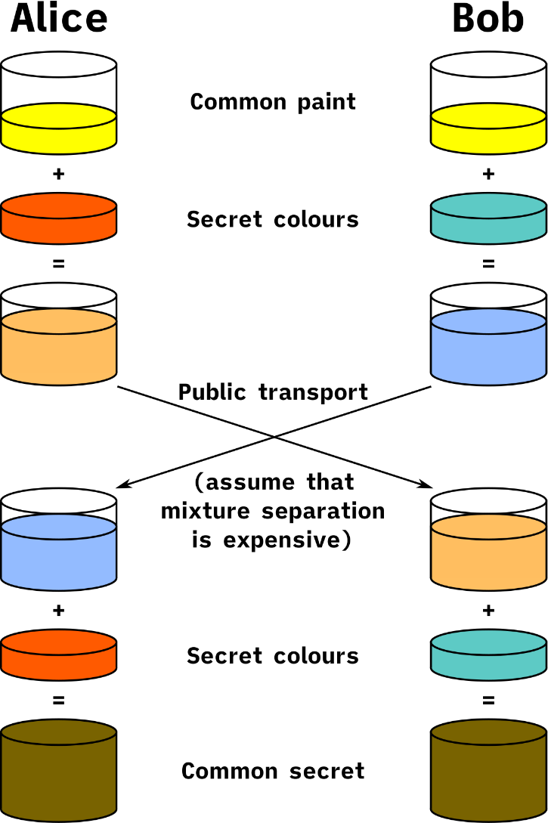
Asymmetric Cryptography (RSA)
We now have a method for sending secure messages over a possibly unsecure channel!
Limitation of RSA: Can only encrypted data that is smaller or equal to key length ( < 2048 bits )

Slide 42
Asymmetric Cryptography (RSA)
We now have a method for sending secure messages over a possibly unsecure channel!
Limitation of RSA: Can only encrypted data that is smaller or equal to key length ( < 2048 bits )
What could we encrypt instead??

Slide 43
Asymmetric Cryptography (RSA)
We now have a method for sending secure messages over a possibly unsecure channel!
Limitation of RSA: Can only encrypted data that is smaller or equal to key length ( < 2048 bits )
What could we encrypt instead??
The key for a symmetric cryptography algorithm! ( < 2048 bits)

Slide 44

Announcements
Last day to drop the class with a “W” grade is tomorrow
Ran into a snafu with PA4, will move discussion to Friday
Wireshark stuff?

Slide 45
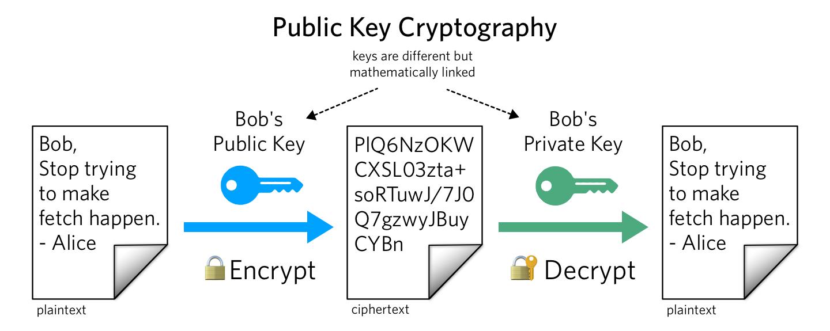
Review
Same key used for encrypting and decrypting
Using block ciphers (AES), we can encrypt an arbitrary size of data
Issue: How to securely share secret keys with each other?
Two keys: Public Key (a lock), and a price key (the key)
Public key is used to encrypt. Private key used to decrypt message
Using math, we can securely send messages over an unsecure channel without sharing any sensitive information
Issue: We can not encrypt stuff bigger than our key (2048 bits)
Often times, symmetric and asymmetric cryptography are used together
(use RSA to send the key for symmetric crypto!)

Slide 46
Today’s Goals:
We need a way to make sure our message does not get tampered with before arrival (message integrity)
We need to find a way to make sure Bob knows these messages are truly coming from Alice (and not someone lying) → Authentication

Slide 47
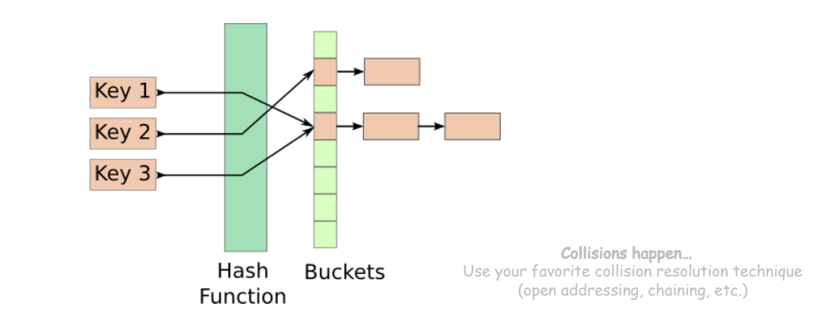
Hash Functions
Hash Functions map arbitrary size data to data of fixed size
An essential building block in cryptography, with desirable practical and security properties
Ex. f(x) = x mod 100
How many buckets?
What to do if two keys map to the same bucket?

Slide 48
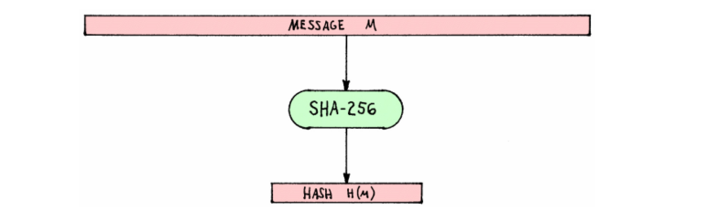
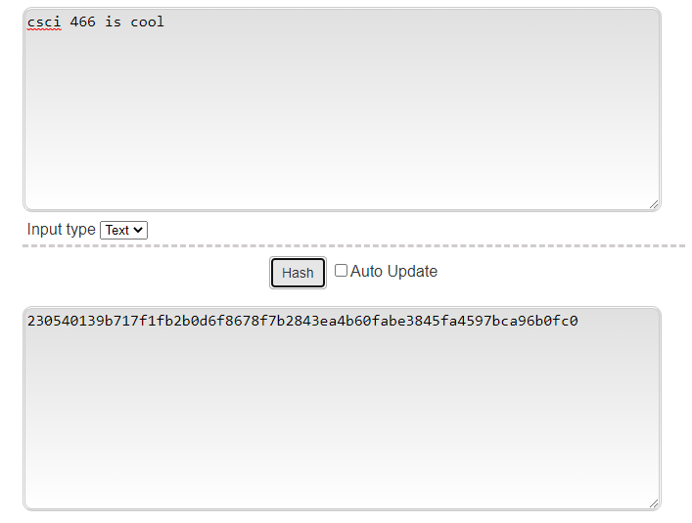
Hash Functions
Cryptographic Hash Functions map arbitrary size data to data of fixed size
But with three additional important properties
Input = Message M
SHA-256 = A cryptographically secure hashing function
Output = Hashed Message M

Slide 49
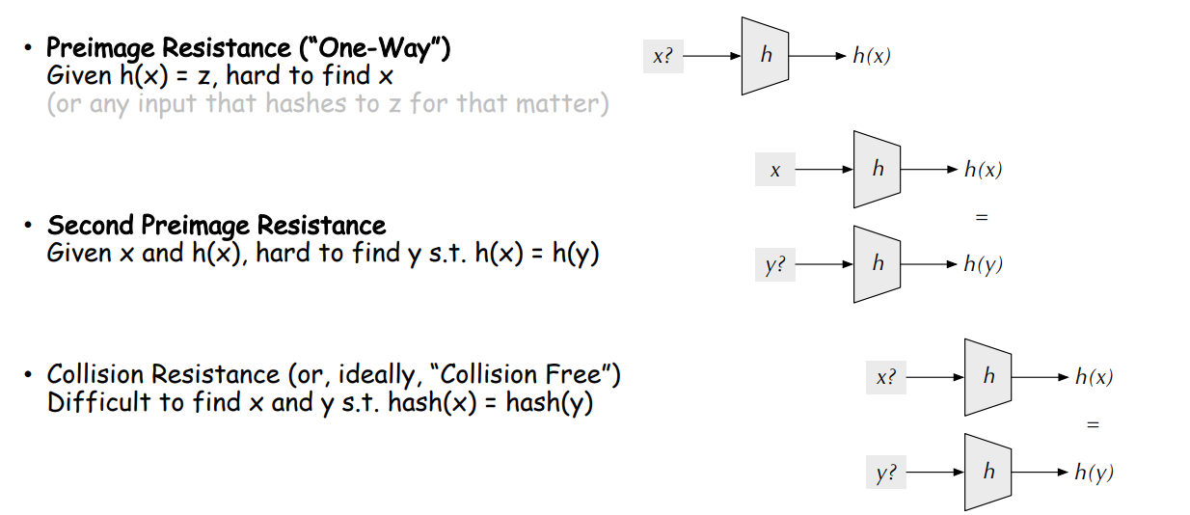
Hash Functions

Slide 50

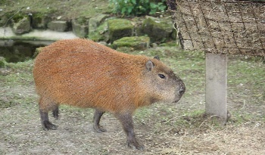

Applications of Hashing
Output space of MD5 (128 bits)
31973ff867a5a4c2546ec4cca1c126b4
MD5
73bd1ddd3ef1051bf5c4bde7a2b5a6c2
c527fc24f5932e932f44c31f1f8c674e
password123
e2ee5b2d1719edef3f8120cff39f0180
FFFFFFFFFFFFFFFFFFFFFFFFFFFFFFFF
What are some uses for hashing?

Slide 51
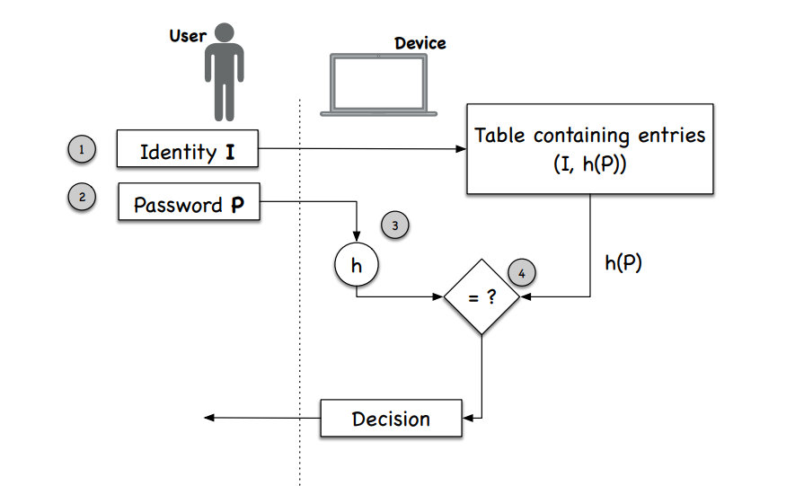
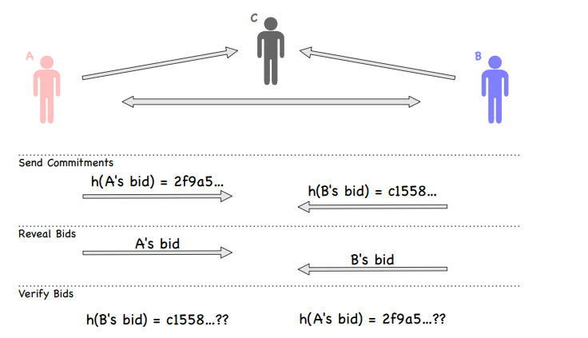
Applications of Hashing
Fairness and Commitment
Disclosing a hash does not disclose the original message
Useful for committing a secret without disclosing the secret itself
Password Storage
Websites don’t store your password in plaintext, instead they store the hash of your password

Slide 52
Applications of Hashing
Fairness and Commitment
Disclosing a hash does not disclose the original message
Useful for committing a secret without disclosing the secret itself
Password Storage
Websites don’t store your password in plaintext, instead they store the hash of your password

Slide 53
Message Integrity
Message Received:
“I love you bob”
“I love you bob”
89defae676abd3e3a42b41df17c40096
Hash
Sarah computes the hash of message prior to sending
Bob receives the message, and computes the hash of the received message
89defae676abd3e3a42b41df17c40096
If the message was not tampered with, or modified, then the hashes should be the same

Slide 54
Message Integrity
Eve tampers with message
“I hate you bob”
Message Received:
“I love you bob”
“I hate you bob”
89defae676abd3e3a42b41df17c40096
Hash
Sarah computes the hash of message prior to sending
Bob receives the message, and computes the hash of the received message
b0608c4e1775ad8f92e7b5c191774c5d
Different hashes = something fishy is going on
If the message was not tampered with, or modified, then the hashes should be the same

Slide 55
Message Integrity
Eve tampers with message
“I hate you bob”
Message Received:
“I love you bob”
“I hate you bob”
89defae676abd3e3a42b41df17c40096
Hash
Sarah computes the hash of message prior to sending
Bob receives the message, and computes the hash of the received message
b0608c4e1775ad8f92e7b5c191774c5d
Different hashes = something fishy is going on
If the message was not tampered with, or modified, then the hashes should be the same

Slide 56
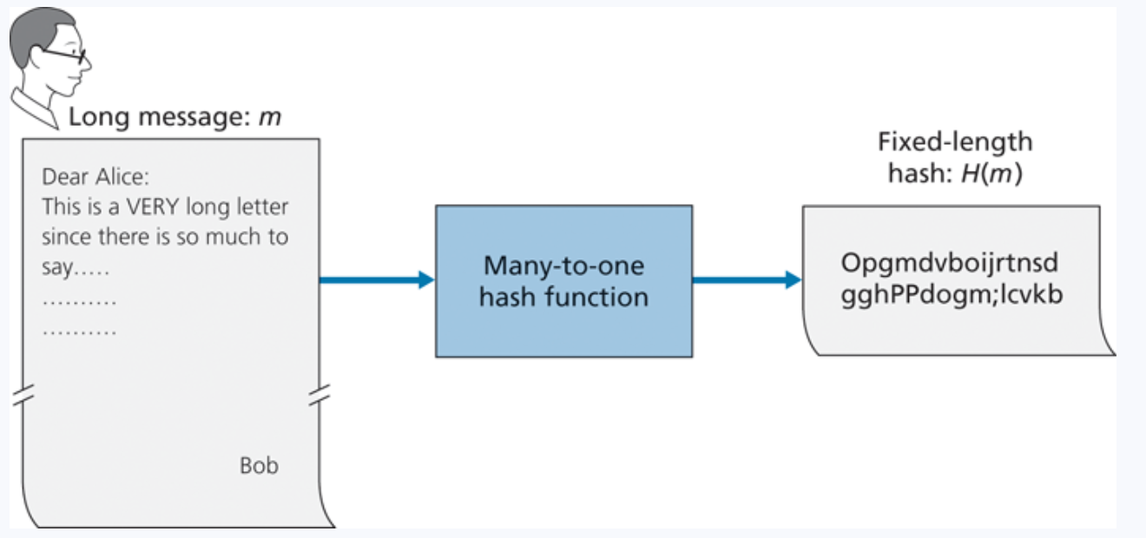
Message Integrity
Hashes provide an irreversible, unique* identifier for a message
*technically not totally true

Slide 57
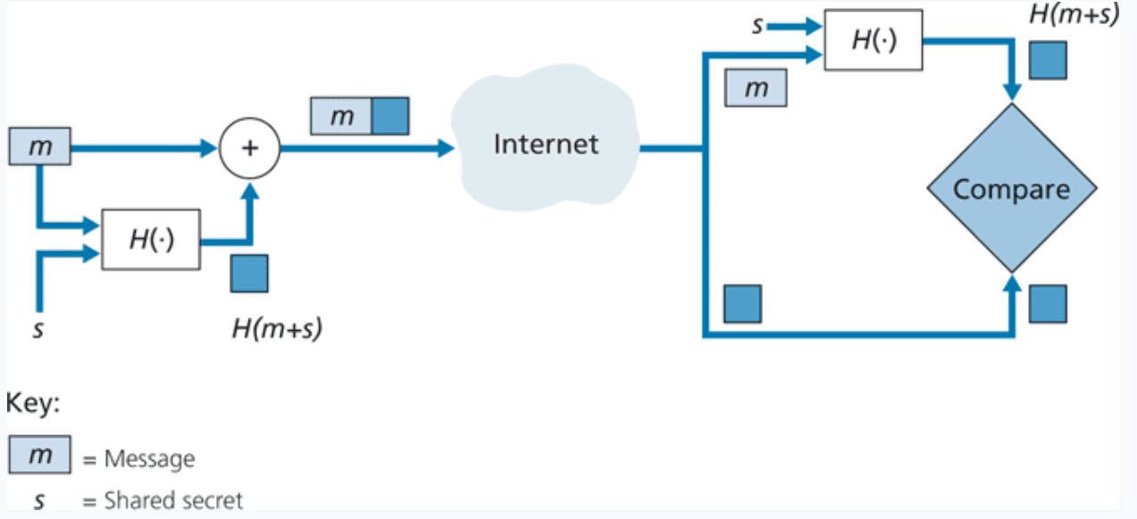
Message Authentication Code (MAC)
Append a message with a shared secret (m + s)
Compute hash of (m+s) → H(m+s)
Send H(m+s) with message m
Sender sends: ( H(m+s), m)
Receiver gets ( H(m+s), m)
Append m with shared secret s (m + s)
Compute H(m+s)
The value receiver computed should match the H(m+s) he received
No encryption required!

Slide 58
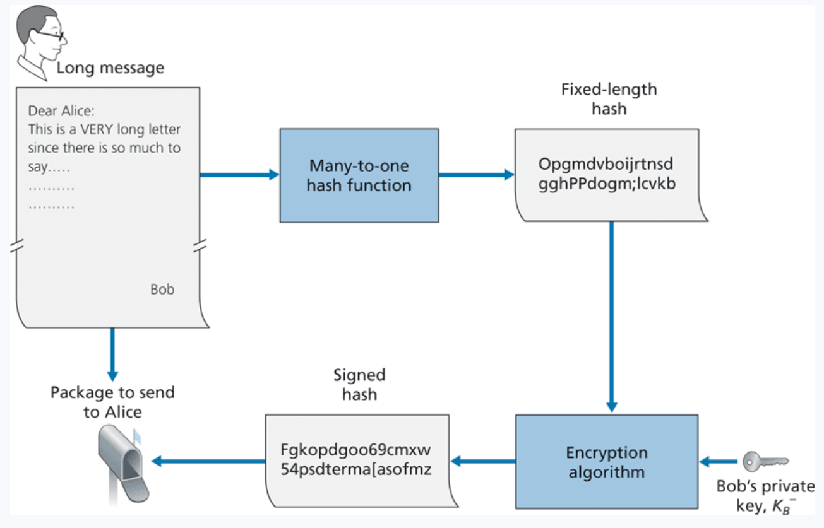
Digital Signatures
What is a unique identifier for bob? What is something that only bob knows and nobody else?
His private key
Bob encrypts his hashed message using his private key, and sends the signed hash, along with message to Alice
When Alice receives this message, she must find a way to decrypt the signed hash
She will use Bob’s public key

Slide 59
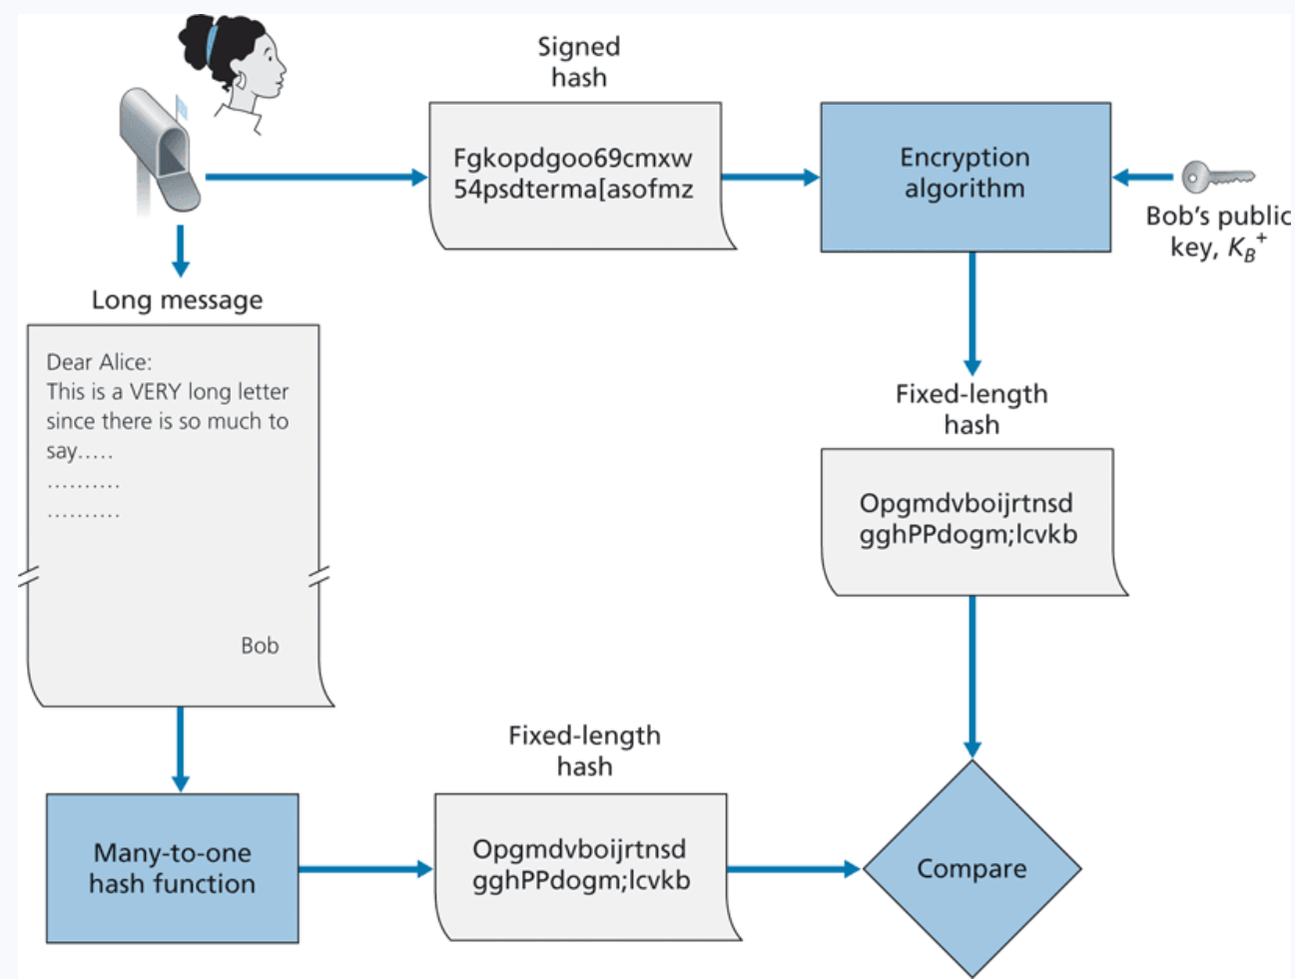
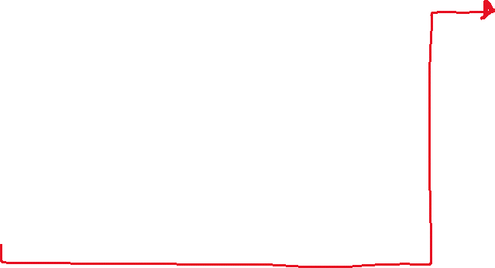
Digital Signatures
What is a unique identifier for bob? What is something that only bob knows and nobody else?
His private key
Bob encrypts his hashed message using his private key, and sends the signed hash, along with message to Alice. Alice decrypts using his public key and verifies that the hashes match
Sending a digital Signature
Verifying a digital signature

Slide 60
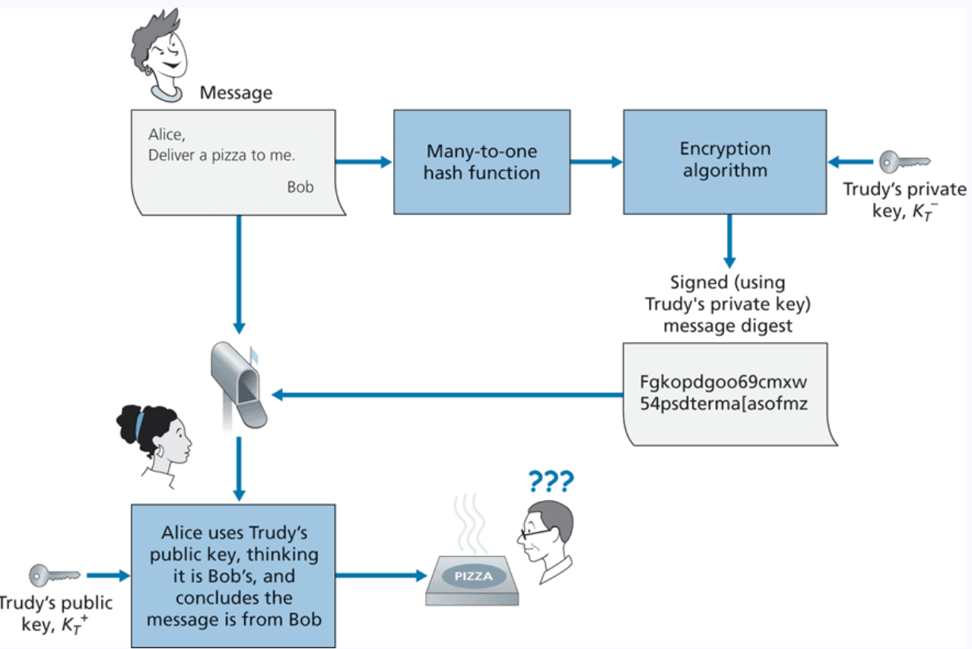

Digital Signatures
How do we know that this is Bob’s public key ?
We don’t have a way to link entities to their public keys

Slide 61
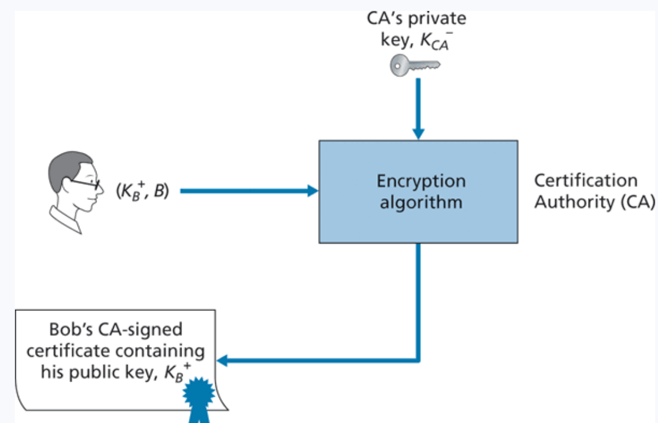
Digital Certificates
Certificates are an authoritative document that links entities (person, router, organization) to their public key
Creating certificates are done by a Certification Authority (digicert, lets encrypt, comodo)
Some are more trustworthy than others…
On your web browser, you exchange certificate information with the websites you are visiting

Slide 62
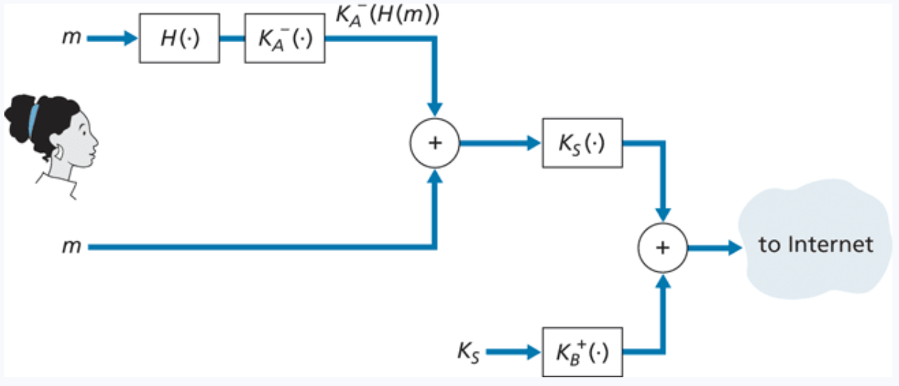






Securing Email
Symmetric Crypto, Asymmetric Crypto, and Hashing all work together to send secure, authentic messages

Slide 63
Announcements
Wireshark Lab 2 due when we get back from Thanksgiving ☺
PA4 will be posted soon, will talk about it on Monday
After today, you will be able to finish HW3
Email me if you need anything over the break

Slide 64
Network Attacks
Disrupt services, steal data, cause damage over a network
TCP related attacks
TCP Reset
TCP Flooding
TCP Hijack
Malicious Network Routing
BGP Hijack
DNS Poisoning
We talk about some of these in-depth in CSCI 476

Slide 65
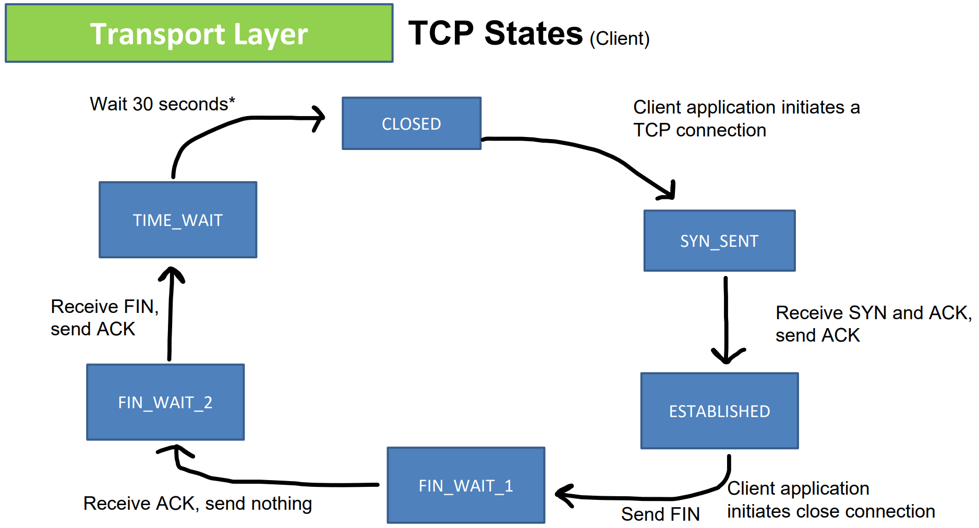
Review of TCP

Slide 66
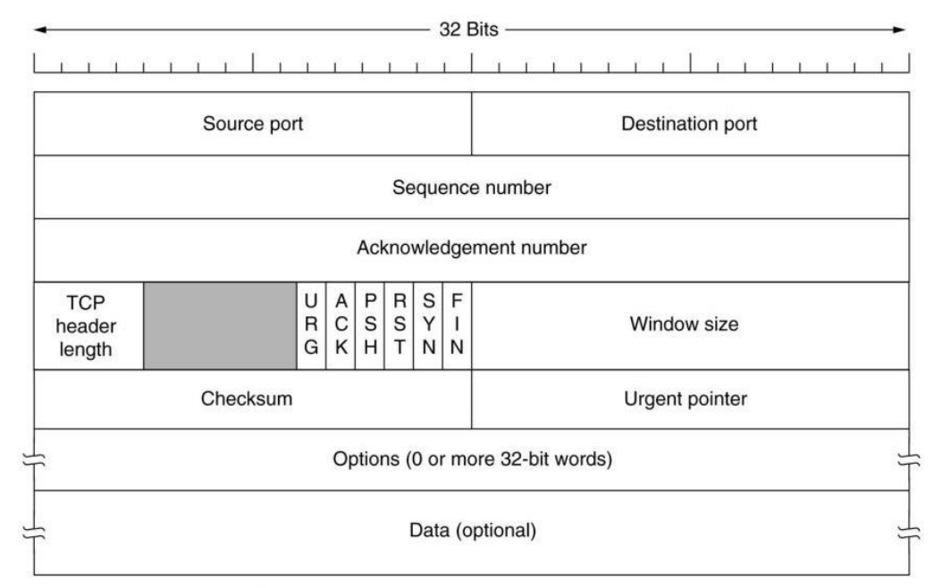
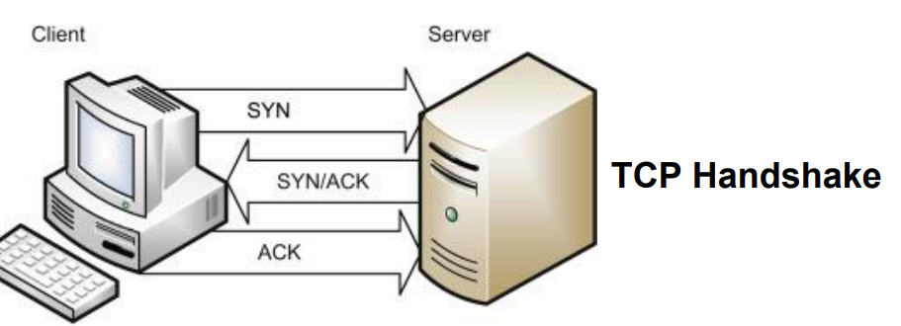


Review of TCP
If the Reset (RST) flag is set (1), then the TCP connection will be reset
If the SYN flag is set(1), then a TCP handshake will be attempted

Slide 67
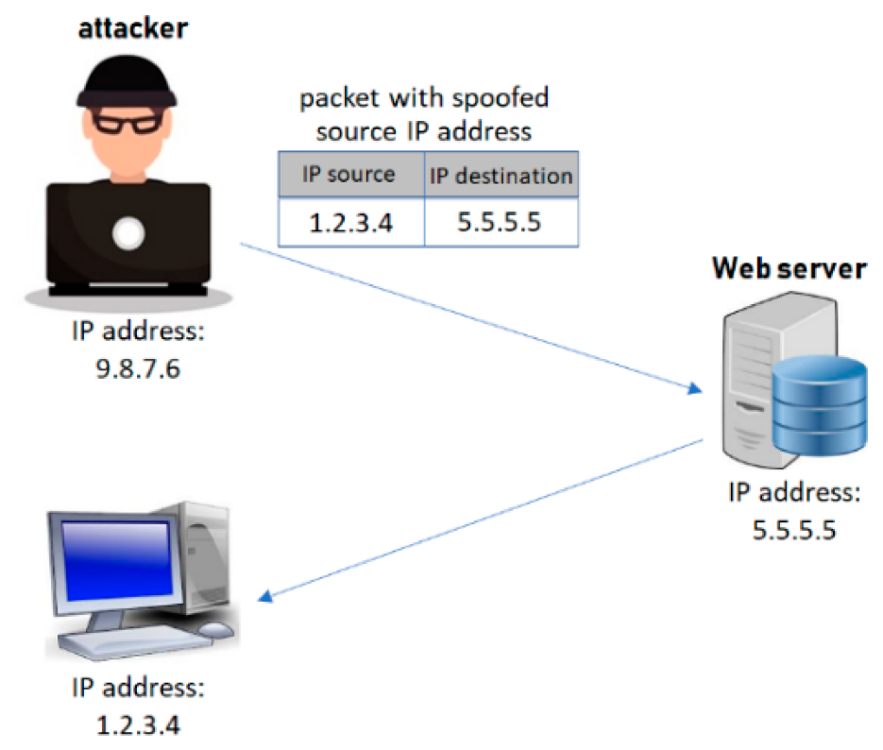
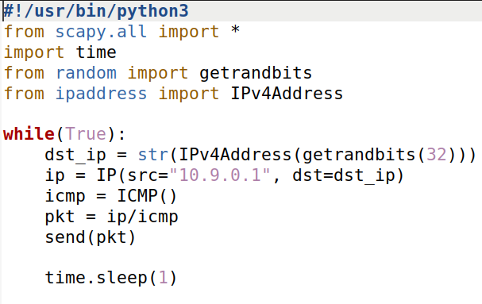
Network Attacks
Packet spoofing is the creation of network packets, typically with the purpose of impersonating another person or system
We can use the scapy module to easily construct spoofed packets
We can use scapy to spoof TCP packets….

Slide 68



SYN Flooding
The Achilles heel:
TCP servers will accept SYN requests, send out SYN+ACK, and wait to receive an ACK
TCP Client
TCP Server
SYN
SYN + ACK
Waiting for an ACK…

Slide 69
SYN Flooding
The Achilles heel:
TCP servers will accept SYN requests, send out SYN+ACK, and wait to receive an ACK
TCP Client
TCP Server
SYN
SYN + ACK
SYN + ACK
Waiting for an ACK…
SYN + ACK
If it does not get an ACK after some amount of time, it will retransmit

Slide 70
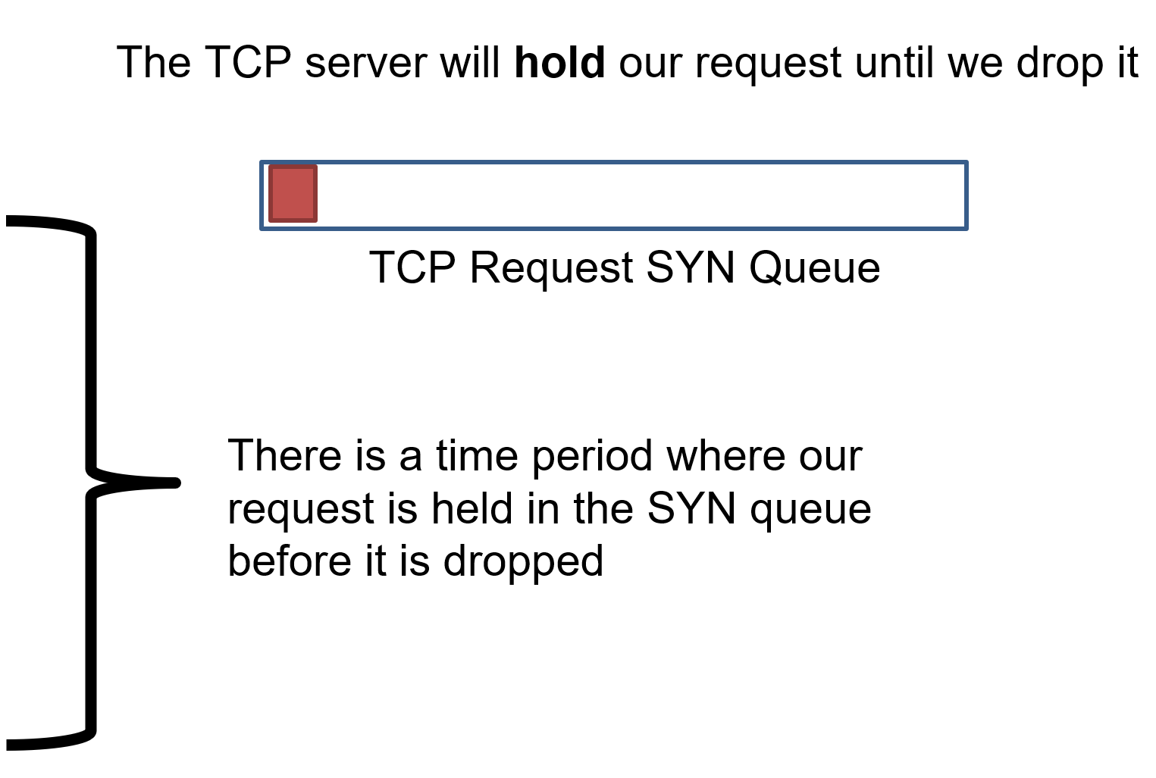
SYN Flooding
The Achilles heel:
TCP servers will accept SYN requests, send out SYN+ACK, and wait to receive an ACK
TCP Client
TCP Server
SYN
SYN + ACK
SYN + ACK
SYN + ACK

Slide 71
SYN Flooding
The Achilles heel:
TCP servers will accept SYN requests, send out SYN+ACK, and wait to receive an ACK
TCP Client
TCP Server
SYN
SYN + ACK
SYN + ACK
SYN + ACK
Goal: Send of a lot of SYN requests form spoofed source IP addresses!

Slide 72
SYN Flooding
The Achilles heel:
TCP servers will accept SYN requests, send out SYN+ACK, and wait to receive an ACK
TCP Client
TCP Server
SYN
The TCP server will hold our request until we drop it
SYN
SYN
SYN
TCP Request SYN Queue
SYN
We can quickly the SYN queue buffer with our spoofed request
SYN
SYN
The TCP server will hold those requests in the queue while it waits
SYN
SYN

Slide 73
SYN Flooding
The Achilles heel:
TCP servers will accept SYN requests, send out SYN+ACK, and wait to receive an ACK
TCP Client
TCP Server
SYN
The TCP server will hold our request until we drop it
SYN
SYN
SYN
TCP Request SYN Queue
SYN
We can quickly the SYN queue buffer with our spoofed request
SYN
SYN
The TCP server will hold those requests in the queue while it waits
SYN
SYN
If the buffer is full…
The TCP server won’t be able to accept new connections!

Slide 74
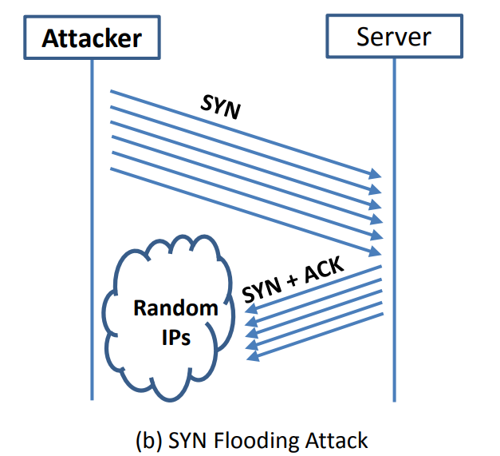
SYN Flooding
The Achilles heel:
TCP servers will accept SYN requests, send out SYN+ACK, and wait to receive an ACK
(The size of this buffer is also set by the operating system)
If a new SYN comes in (from a legitimate user), they will be denied

Slide 75
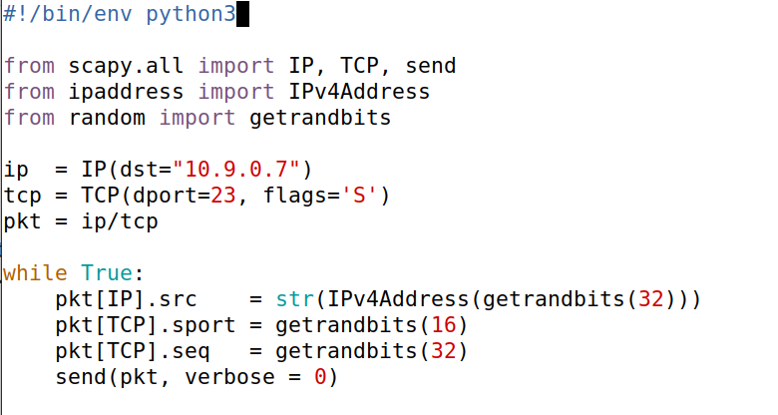
IP address of the victim server
Set the SYN flag
1
Repeatedly send a TCP packet to 10.9.0.7, with a random source IP address
1

Slide 76
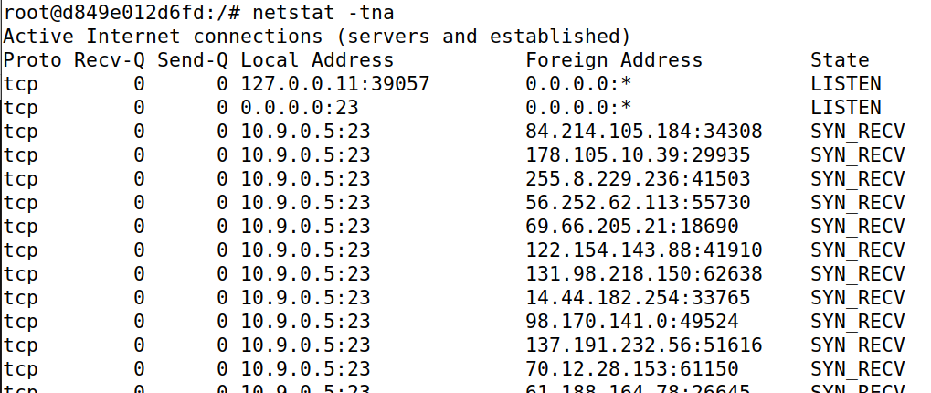
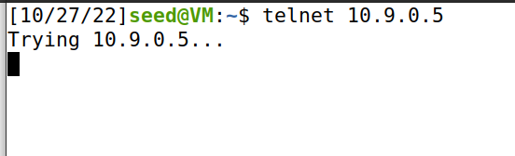
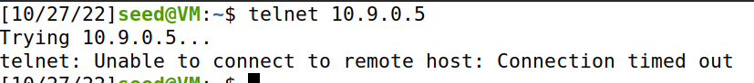



Attacker
New terminal
Server is full!
synflood.py
We’ve filled this server with spoofed SYN requests
Denied
1
Repeatedly send a TCP packet to 10.9.0.7, with a random source IP address
1

Slide 77
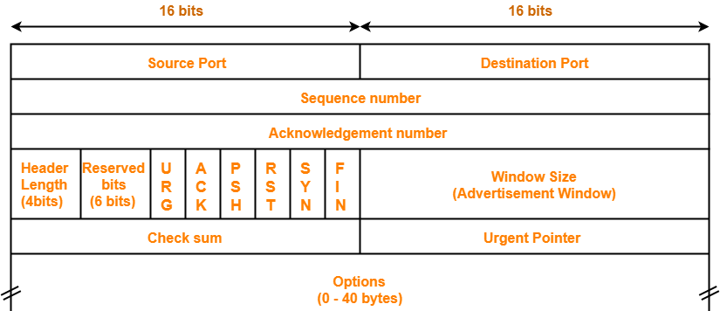

TCP Reset
Goal: Break an established TCP connection by sending a spoofed RESET (RST) packet
Packet

Slide 78
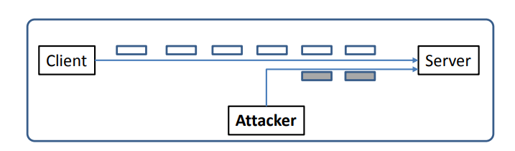
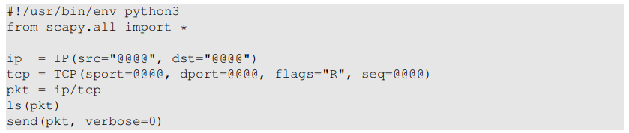

TCP Reset Attack
In order to do our attack, we first need to find an ongoing TCP communication between two users!
A server reads data in some order (typically by sequence number)
To detect an already-existing TCP connection, we will use wireshark!
10.9.0.6
10.9.0.5
SEQ # = 4440
10.9.0.1
If the server gets a SEQ# of something below 4440, it will ignore it
In our spoofed packet, we need to make sure we select a sequence number that matches the sequence number the server is expecting!
(@@@ are placeholders)
We also need to select the same ports!

Slide 79
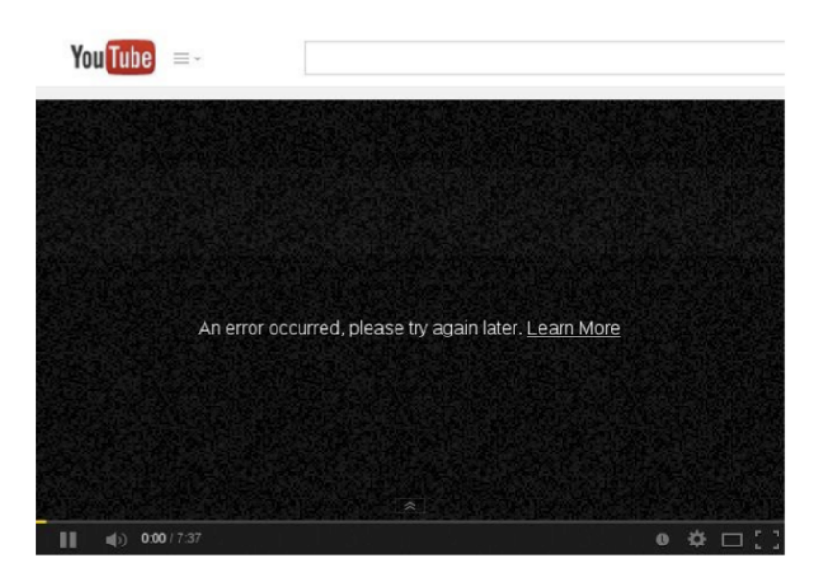

Slide 80
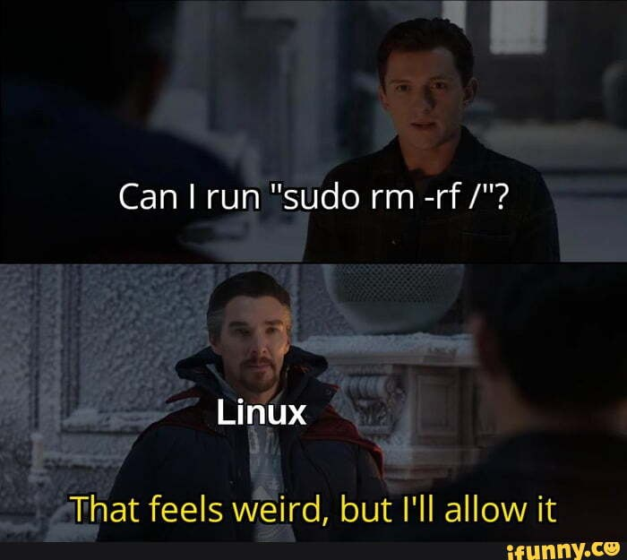
TCP Hijack Attack
Hijack a current TCP connection and get a TCP server (a telnet connection) to execute commands of our choice
Possible commands we might want to execute:
cat secret_password.txt
rm –rf /
10.9.0.6
10.9.0.5
10.9.0.1
*We need to make sure the spoofed packet as a SEQ # and an ACK # that the TCP server is expecting
Spoofed Packet
Src: 10.9.0.6
Dst: 10.9.0.5
Command: rm-rf /

Slide 81
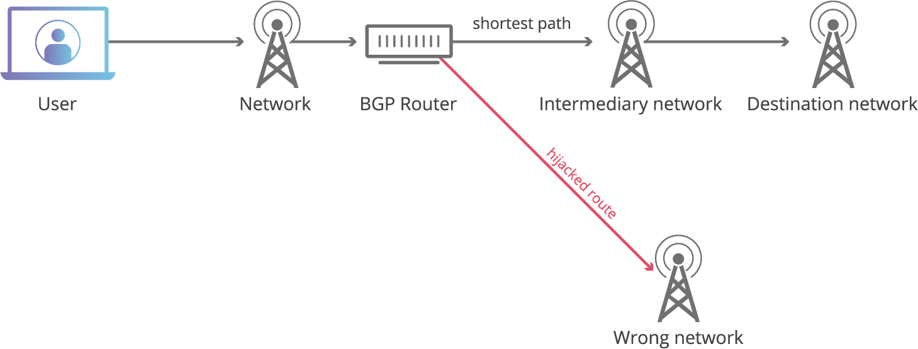
BGP Hijack
BGP is the routing protocol used to connect autonomous systems
Routers send BGP messages to advertise which network prefixes they have access to
If we can trick a BGP router into accepting our bogus routing advertisements, we can redirect traffic
(Do something malicious)

Slide 82
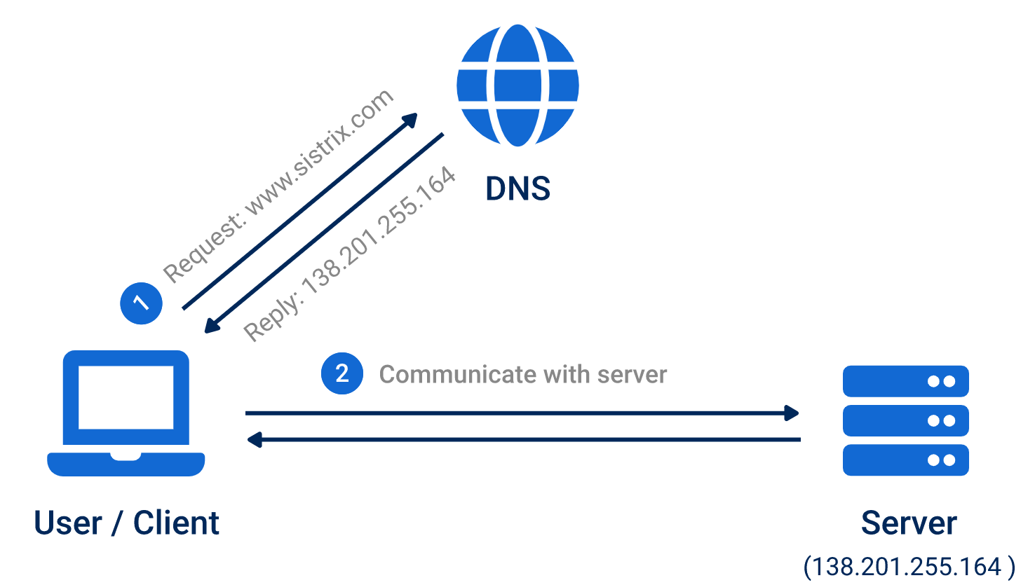
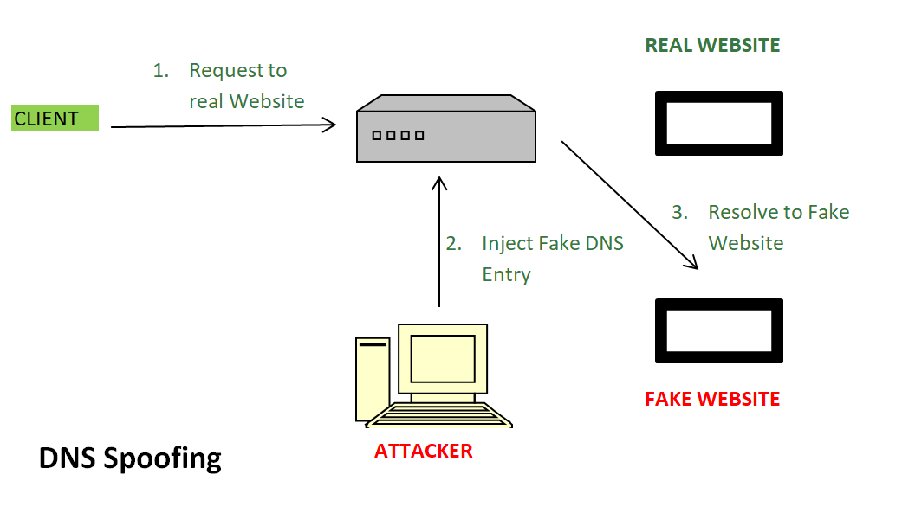
DNS Poisoning
How normal DNS works
Attack is going to inject false DNS entries for legitimate services (montana.edu) and link a malicious IP address for a fake website
If a DNS server is waiting for a DNS query response, we could (very quickly) send a spoofed DNS resolution packet that looks like its coming from a legitimate source

Slide 83
Announcements
Wireshark Lab 2 due tonight @ 11:59PM
HW3 due on Friday at 11:59 PM
PA3 grades are posted
Will post a final exam study guide + HW4 on Wednesday
Class will start late on Wednesday (~10min)
Course Evals are open

Slide 84
PA4

Slide 85





Security Review
Confidentiality (Encryption)
Message Integrity and Authentication (Hashing)
Symmetric Crypto, Asymmetric Crypto, and Hashing all work together to send secure, authentic messages

Slide 86
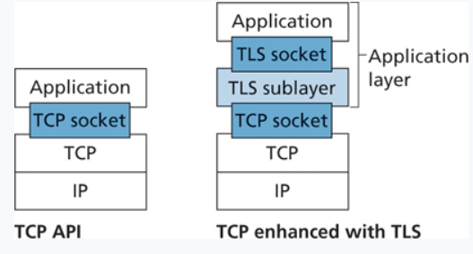

So, where is this all happening?
Transport Layer Security (TLS) is a protocol used to provide communication security over a TCP connection
This exists somewhere between the application layer and transport layer
Port 443
TLS will always be running if you are doing web communication with https
https = Hypertext Transfer Protocol Secure
HTTPS/TLS will handle all the encryption, key generation, certificate checking, authentication for you!
UDP does not use TLS

Slide 87

TLS Handshake
A new and improved handshake!
TLS/SSL does not mandate that two users use a specific symmetric key algorithm
TLS connection can be closed using a TCP FIN

Slide 88

Network-Layer Security
(IPv4 Packet)
We have security at the transport layer, but we might also desire security at a network-layer level
The IP security protocol (IPsec) provides data integrity, origin authentication, attack prevention, and confidentiality at the network-layer
IPsec is most commonly seen when using a Virtual Private Network (VPN)
This could be a TCP segment (unencrypted), TLS segment, UDP segment, ICMP packet etc
Public Network- Anyone can access/communicate with the devices on the network
Private Network- Completely isolated from public internet, typically reserved for a particular institution (this can be costly)

Slide 89




VPNs
IPsec is most commonly seen when using a Virtual Private Network (VPN)
Public Network- Anyone can access/communicate with the devices on the network
Private Network- Completely isolated from public internet, typically reserved for a particular institution (this can be costly)
VPNs extend a private network over a public network
All messages get encrypted prior to entering any public network (using IPsec), and rerouted through a secure network
Converts vanilla IPv4 datagrams to IPsec datagrams
When a source IPsec entity (host or router) sends secure datagrams to a destination entity, it does so with either the Authentication Header (AH) protocol, or the Encapsulation Security Payload (ESP) protocol

Slide 90

Ipsec and security associations
Transport Mode
IPsec datagram emitted and received by end-system
protects upper level protocols
IPsec
IPsec
Tunnel Mode
edge routers IPsec-aware
IPsec
IPsec

Slide 91
Ipsec and security associations
Authentication Header (AH) protocol
provides source authentication & data integrity but not confidentiality
Encapsulation Security Protocol (ESP)
provides source authentication, data integrity, and confidentiality
more widely used than AH

Slide 92

Ipsec and security associations
before sending data, “security association (SA)” established from sending to receiving entity
SAs are simplex: for only one direction
ending, receiving entitles maintain state information about SA
recall: TCP endpoints also maintain state info
IP is connectionless; IPsec is connection-oriented!
The security association from R1 to R2 will contain information about keys, certificates, encryption mode, security identifiers

Slide 93

Ipsec Datagram

Slide 94

Endpoint Security
A firewall is a combination of hardware and software that isolates an organizations internal network form the internet at large, allowing some packets to pass, and blocking others
Three goals
All traffic from outside to inside, inside to outside, passes through the firewall
Only authorized traffic (defined by firewall’s policy) will be allowed to pass
The firewall itself is immune to penetration

Slide 95
Types of Firewalls
Packet Filter
Analyze packet’s details, and make decision.
Look at IPs, Ports, Protocol, TCP Flags, ICMP Type, and more
Example Polices
Policy | Rules
No outside web access.

Slide 96
Types of Firewalls
Packet Filter
Analyze packet’s details, and make decision.
Look at IPs, Ports, Protocol, TCP Flags, ICMP Type, and more
Example Polices
Policy | Rules
No outside web access. | Drop all outgoing packets to any IP address, port 80 or 443

Slide 97
Types of Firewalls
Packet Filter
Analyze packet’s details, and make decision.
Look at IPs, Ports, Protocol, TCP Flags, ICMP Type, and more
Example Polices
Policy | Rules
No outside web access. | Drop all outgoing packets to any IP address, port 80 or 443
No incoming TCP connections

Slide 98
Types of Firewalls
Packet Filter
Analyze packet’s details, and make decision.
Look at IPs, Ports, Protocol, TCP Flags, ICMP Type, and more
Example Polices
Policy | Rules
No outside web access. | Drop all outgoing packets to any IP address, port 80 or 443
No incoming TCP connections | Drop all incoming TCP SYN packets
Prevent your network from being tracerouted

Slide 99
Types of Firewalls
Packet Filter
Analyze packet’s details, and make decision.
Look at IPs, Ports, Protocol, TCP Flags, ICMP Type, and more
Example Polices
Policy | Rules
No outside web access. | Drop all outgoing packets to any IP address, port 80 or 443
No incoming TCP connections | Drop all incoming TCP SYN packets
Prevent your network from being tracerouted | Drop all incoming/outgoing ICMP traffic

Slide 100

Types of Firewalls
Packet Filter
Analyze packet’s details, and make decision.
Look at IPs, Ports, Protocol, TCP Flags, ICMP Type, and more
Access Control List
Allow/Deny Traffic

Slide 101


Types of Firewalls
Stateful Filter
→ Make decisions based on connection information
Access Control List for Stateful Filter
Firewall may keep an internal table

Slide 102


Types of Firewalls
Application Gateway
→ Make decisions based on application data, as well as IP/TCP/UDP data
host-to-gateway
telnet session
application
gateway
example: allow select internal users to telnet outside
router and filter
gateway-to-remote
host telnet session

Slide 103
Intrusion Detection System
To detect attacks, we need to perform deeper inspection
A series of packets
The context of a packet
Application Data of a Packet
An instruction detection system (IDS) will generate an alert when potentially malicious traffic is observed
An instruction prevention system (IPS) filters out suspicious traffic, prior to traffic arriving to network
What might suspicious traffic look like?

Slide 104
Intrusion Detection System
To detect attacks, we need to perform deeper inspection
A series of packets
The context of a packet
Application Data of a Packet
An instruction detection system (IDS) will generate an alert when potentially malicious traffic is observed
An instruction prevention system (IPS) filters out suspicious traffic, prior to traffic arriving to network
What might suspicious traffic look like?
Communication with foreign, unknown IP address
Unauthorized web traffic
A large spike in traffic

Slide 105
Intrusion Detection System
An instruction detection system (IDS) will generate an alert when potentially malicious traffic is observed
Two types –
1. Signature-Based Detection Systems
Maintain a large database of known “signatures” for malicious packets
-- Malicious IP addresses or URLs -- Email Addresses
-- Specific String of Bits -- File/Message Hashes
-- Protocol Specific (nmap)
When would signature-based detection not work ?

Slide 106
Intrusion Detection System
An instruction detection system (IDS) will generate an alert when potentially malicious traffic is observed
Two types –
1. Signature-Based Detection Systems
Maintain a large database of known “signatures” for malicious packets
-- Malicious IP addresses or URLs -- Email Addresses
-- Specific String of Bits -- File/Message Hashes
-- Protocol Specific (nmap)
When would signature-based detection not work ?
Signature-based detection will never work for new threats, so we need a way to dynamically analyze threats
2. Anomaly-based Detection System
If you know what “normal” traffic looks like, you can identify unusual, potentially malicious traffic
You get a large spike in ICMP packets? Someone might be trying to NMAP you

Slide 107


Intrusion Detection System
Security/Network Engineers will look for Indicators of Compromise (IOCs) to determine if a network may have been breached
These are a variety of digital forensics that can be collected

